Slide 1



V
Apr 10, 2025
My Weekly
Updates
Song-Ze, Yu

Slide 2
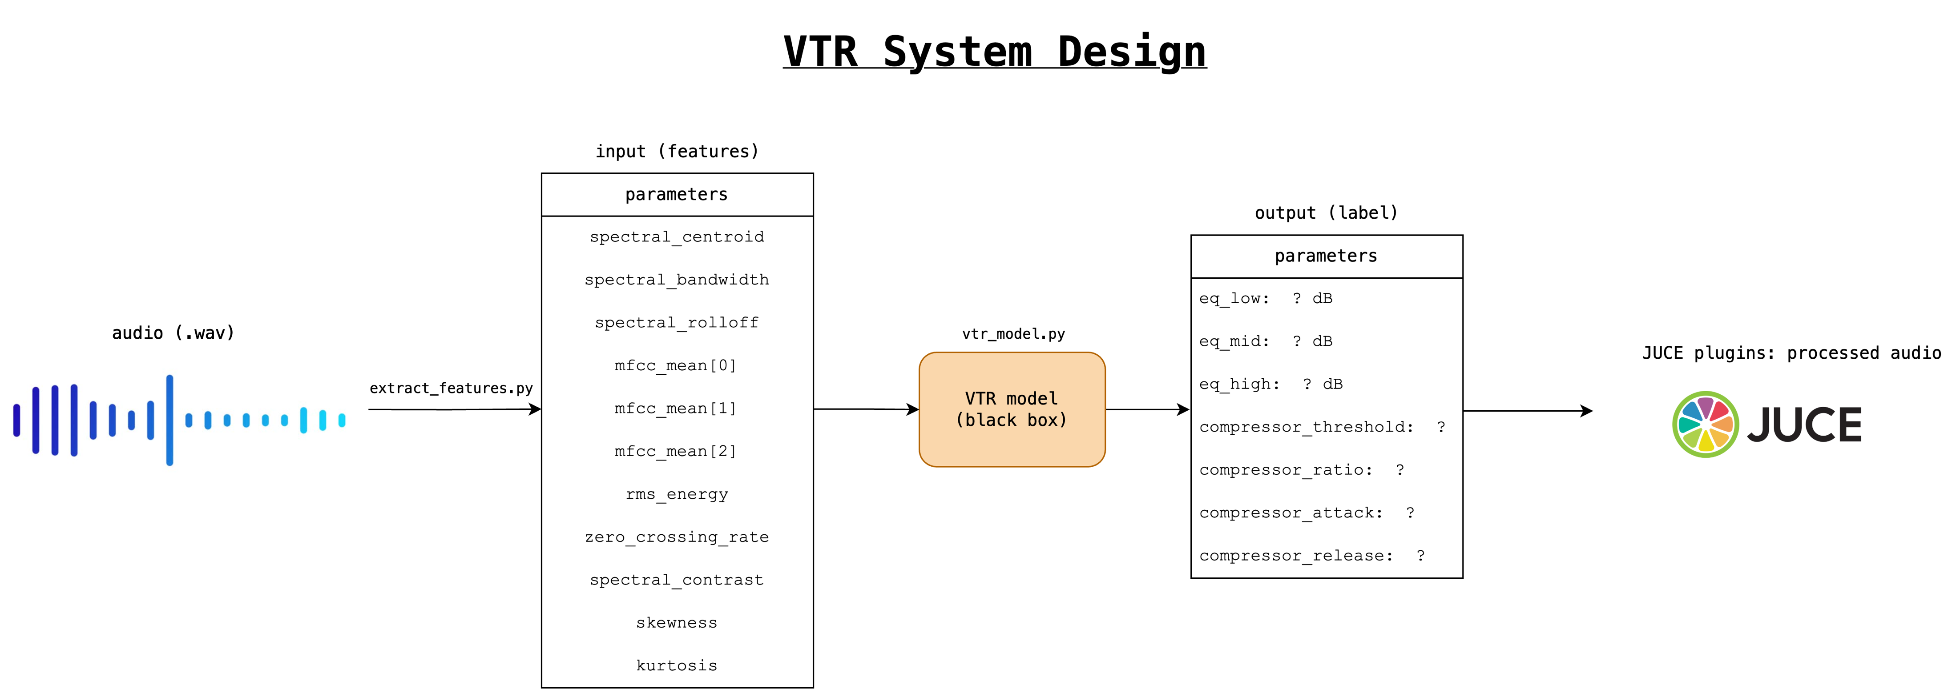

Slide 3
VTR System Workflow
1. Dataset making
2. Extract features (e.g., spectral centroid, MFCC): model input
3. Attach label (EQ and compressor parameter): model output and ground truth
4. Model training / inference: regression/SVM and classification first, NN if available
5. Evaluate tone recognition performance
6. Write the JUCE interface if available

Slide 5
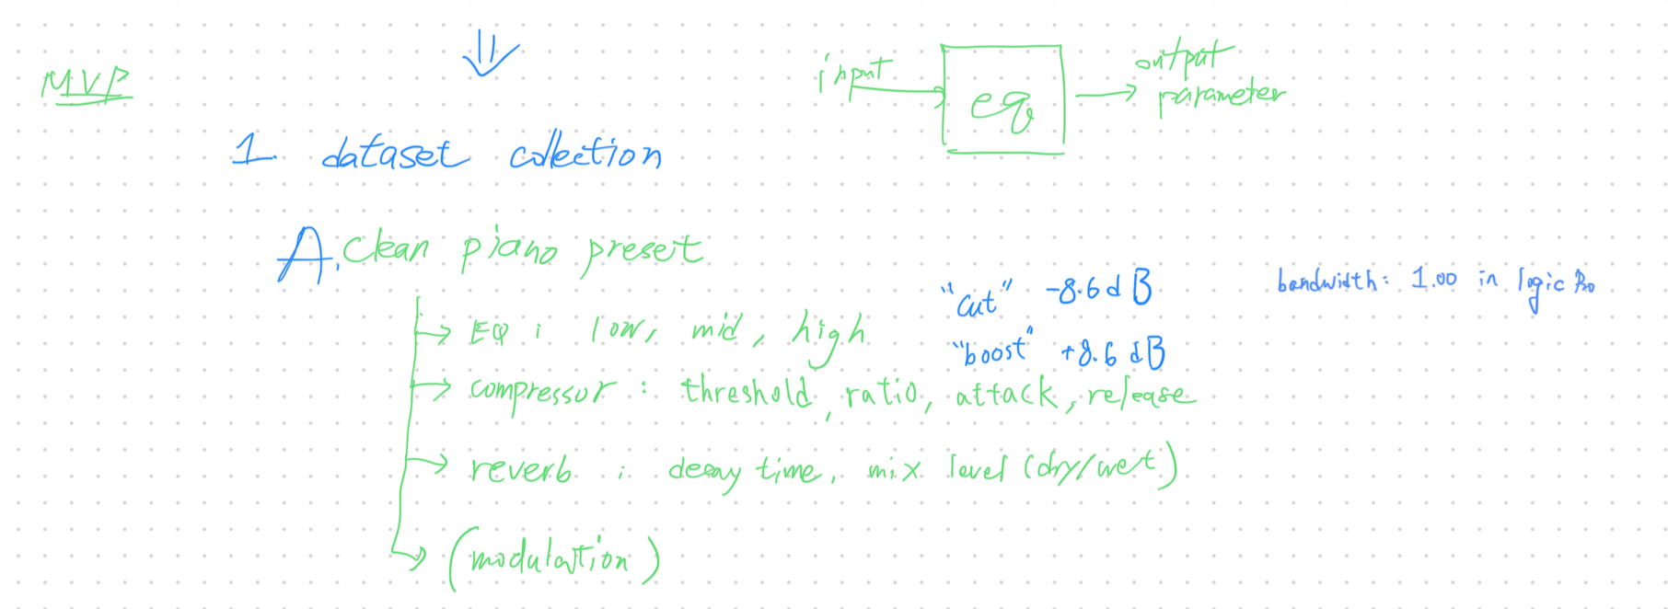
MVP Architecture
Create my own dataset
Goal: 500 samples

Slide 6
Progress: Dataset generating

Slide 7
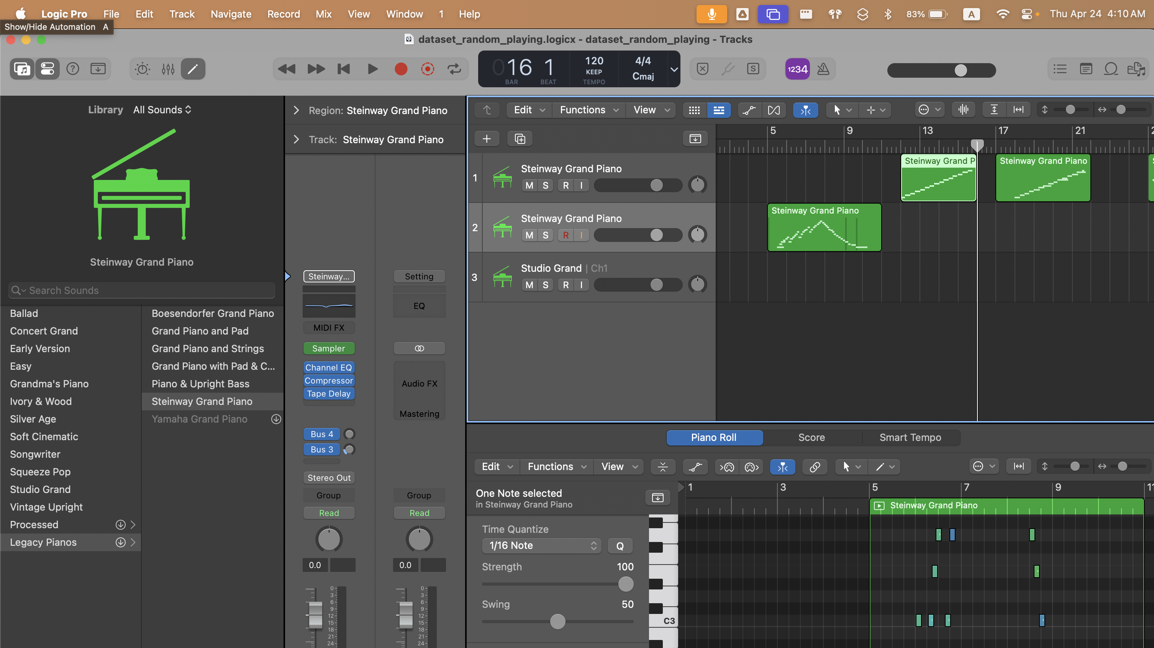
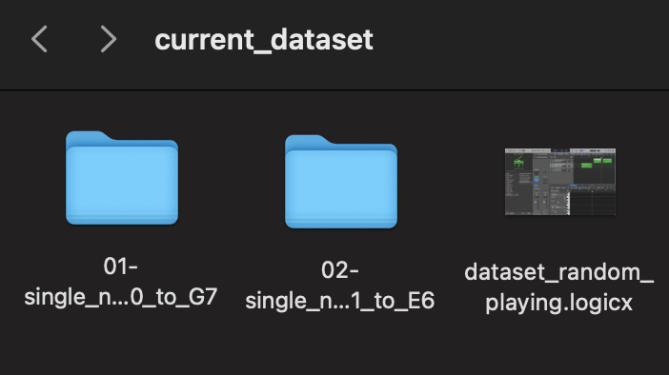
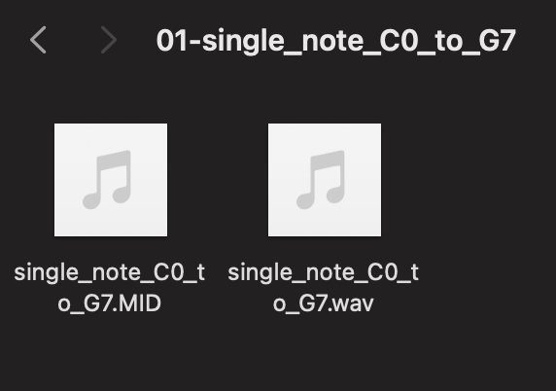

Slide 8
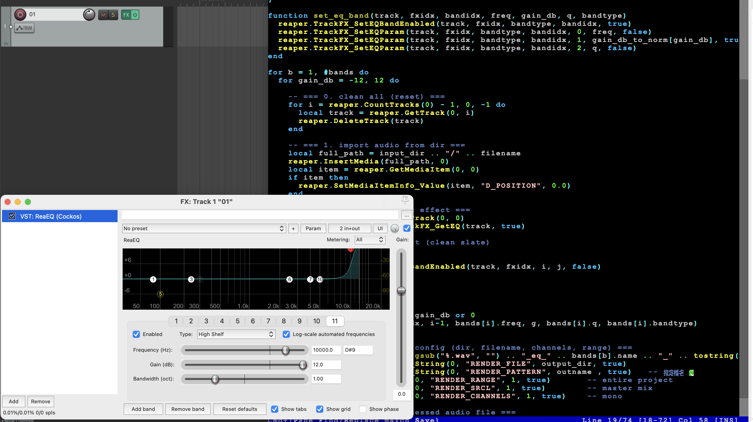

Slide 9
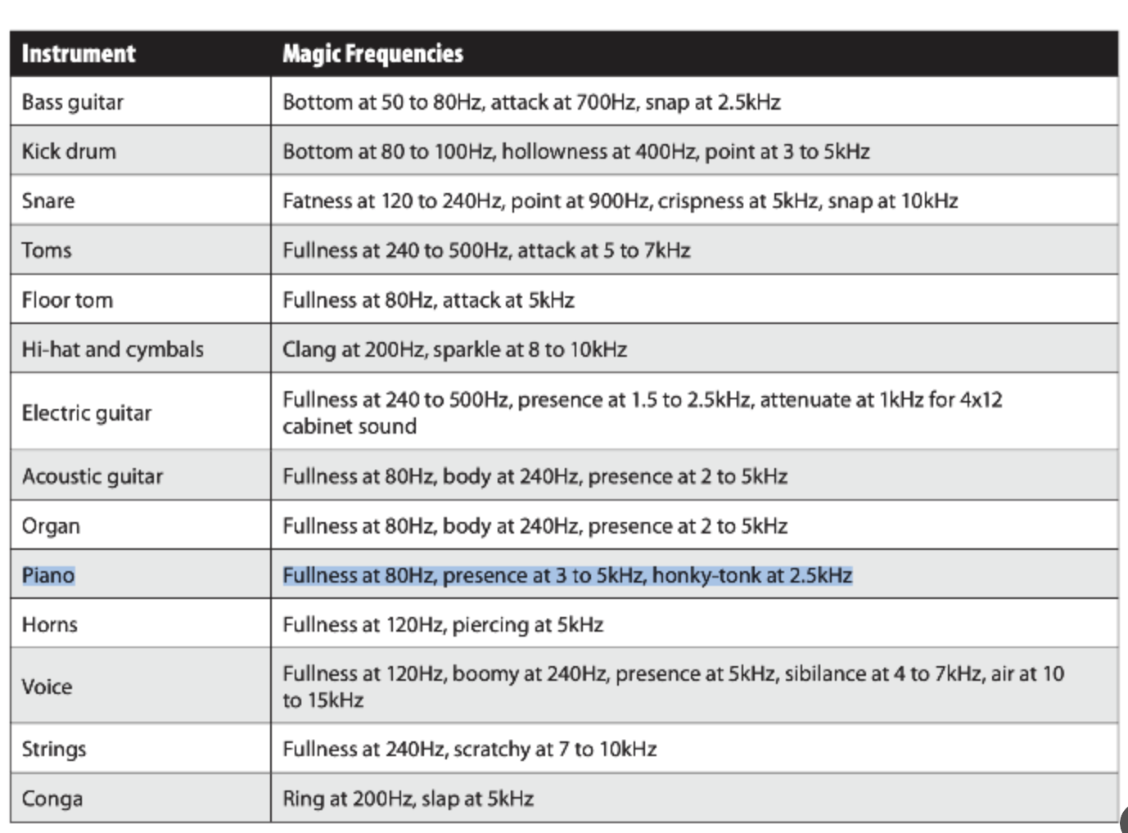
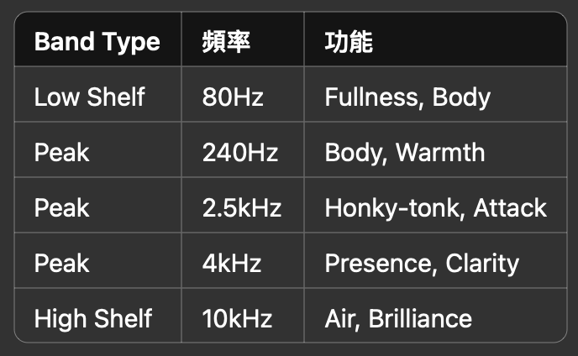

Slide 10
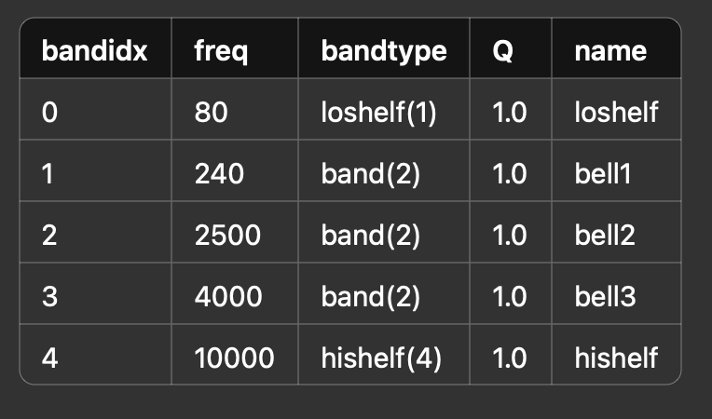
Experiment 1: Single band sweep -12~+12dB (1dB as a unit)

Slide 11
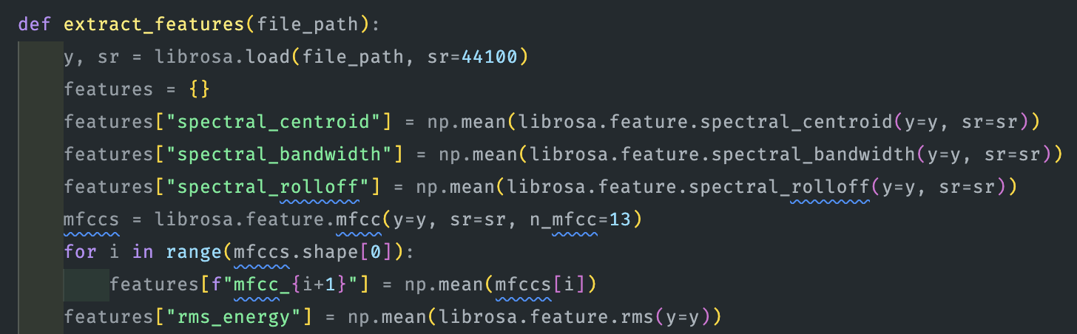
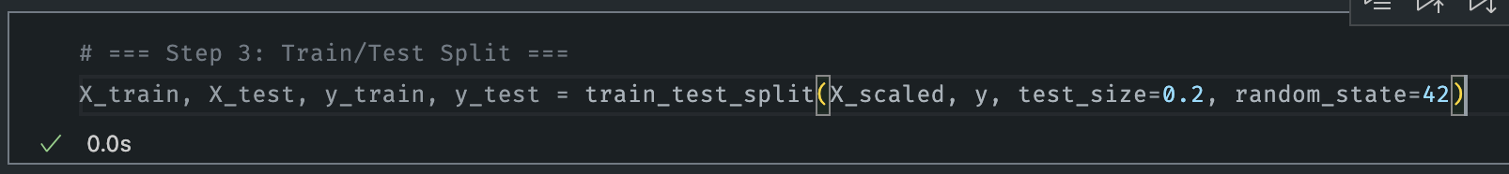

Slide 12
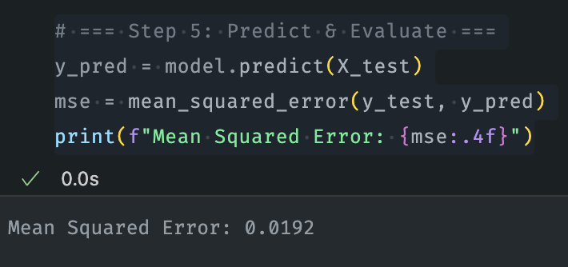
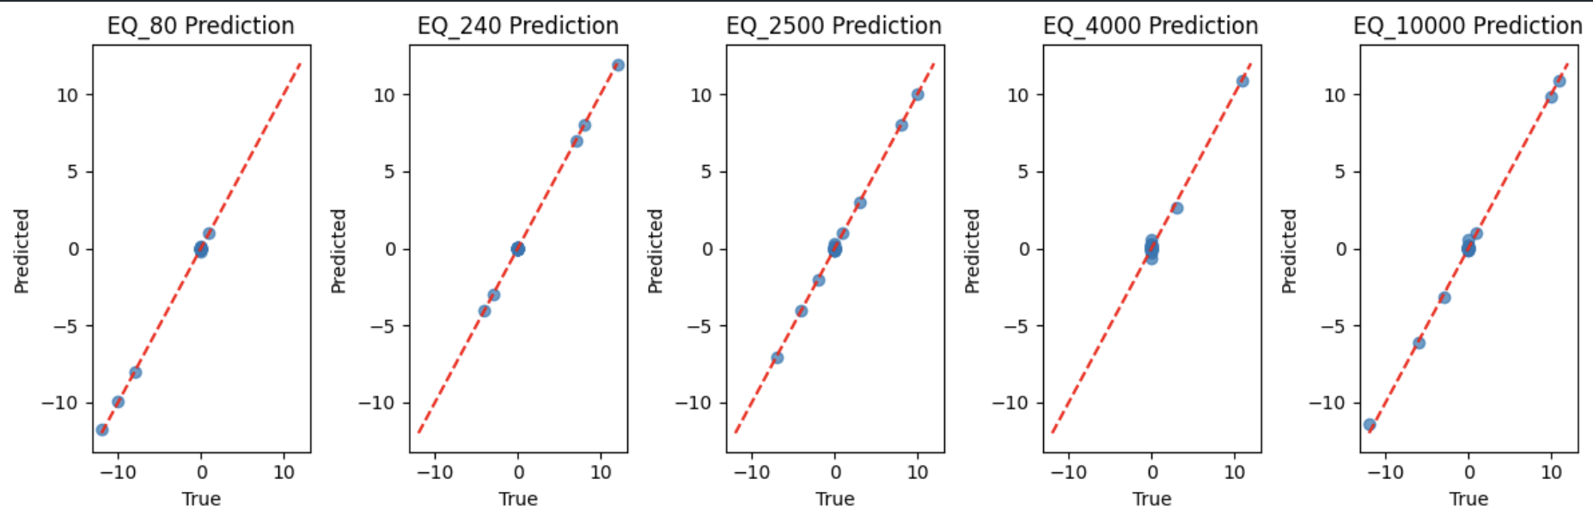
Baseline Model implementation (Regression)

Slide 13
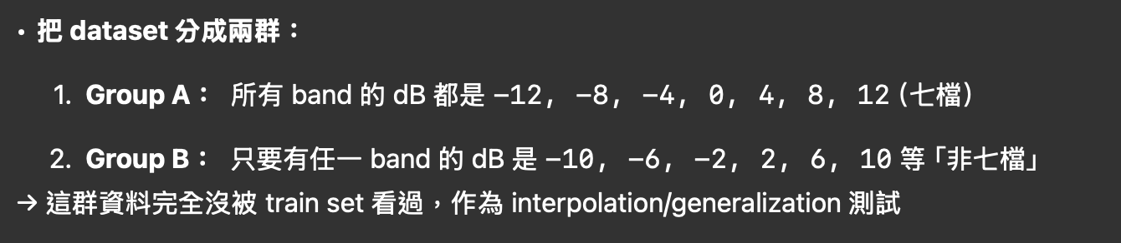
Experiment 2: Single band sweep -12~+12dB (4dB as a unit)

Slide 14
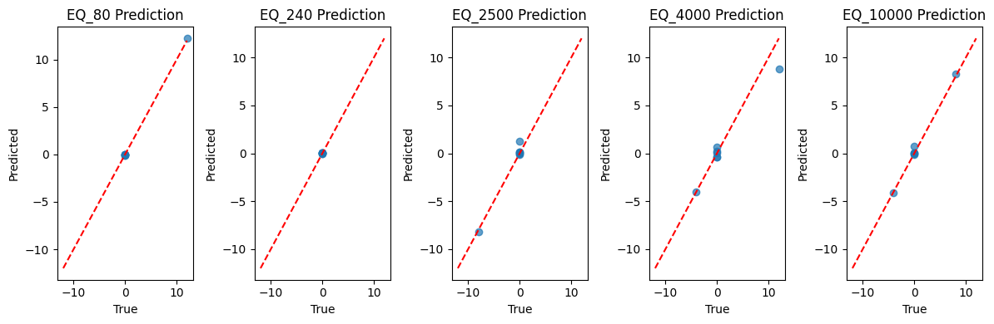
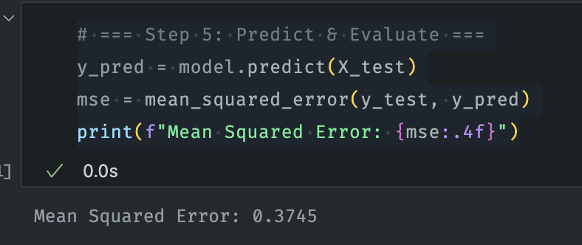
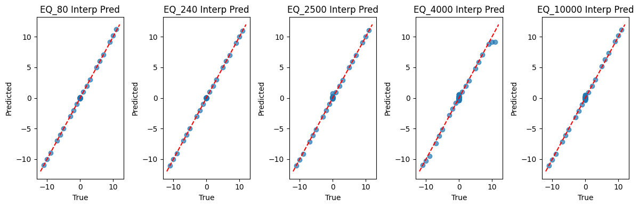
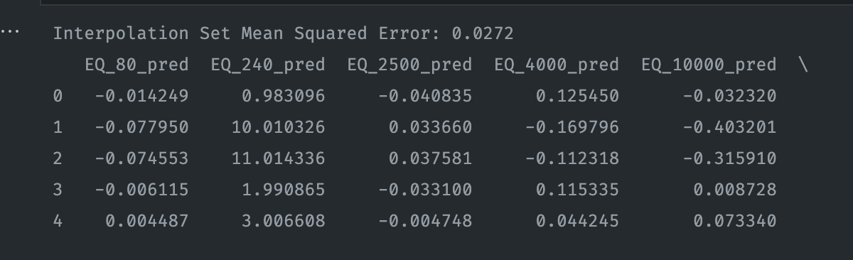
Concludes: We don’t need to actually run this small unit, and also the model learns good not only mapping the answer.

Slide 15
Experiment 3: Multi band sweep -12~+12dB (1dB as a unit)

Slide 16
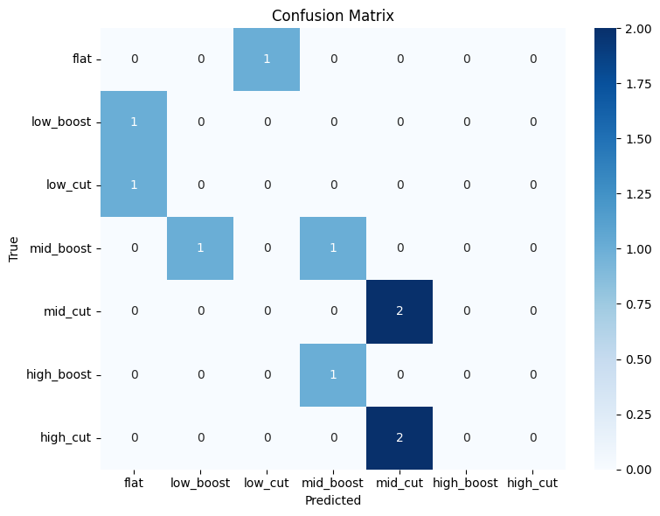
Progress: Model implementation (Classification)

Slide 17

V
Thank you!
Now, what’s next?

